Slide 1

Employee Career Path Navigator

Slide 2

PROBLEM STATEMENT
Employees encounter challenges in navigating their career trajectories due to dynamic shifts in organizational vision and strategies.
Specifically, Employee A, currently a Software Developer in the Supply Chain domain for two years, is grappling with the complexities of identifying suitable career paths.
The rapid evolution of our enterprise landscape necessitates a solution that offers personalized career recommendations.

Slide 3
OUTCOMES
Personalized Career Assessments
Intuitive User Interface
Learning Platform Integration
Instills confidence through strategic skill development

Slide 4
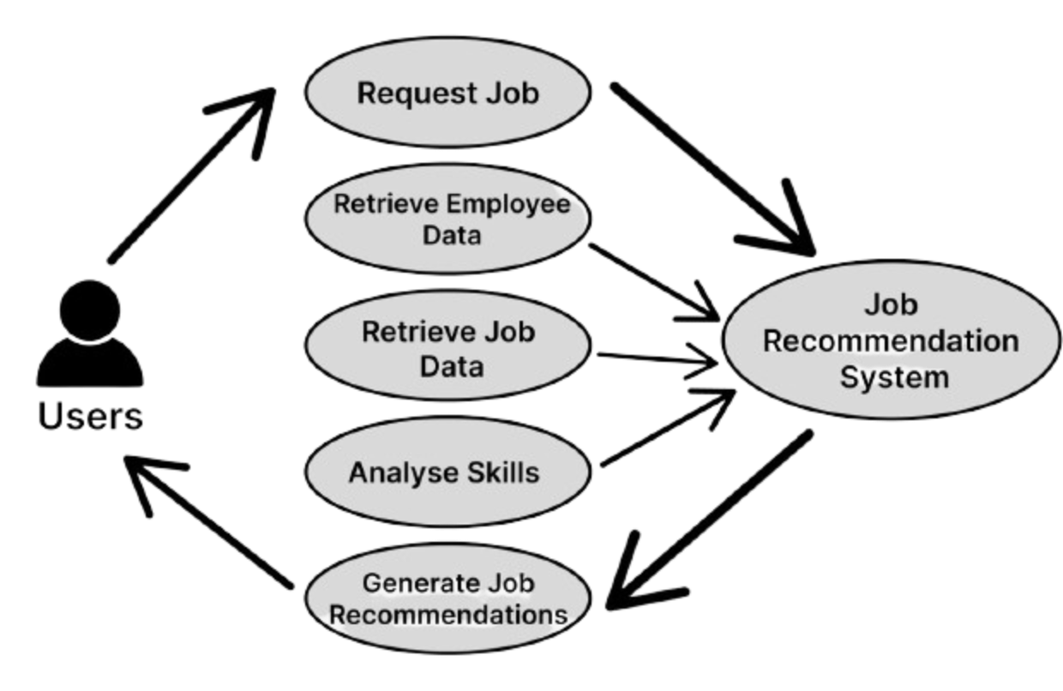
Use Case UML Diagram

Slide 5
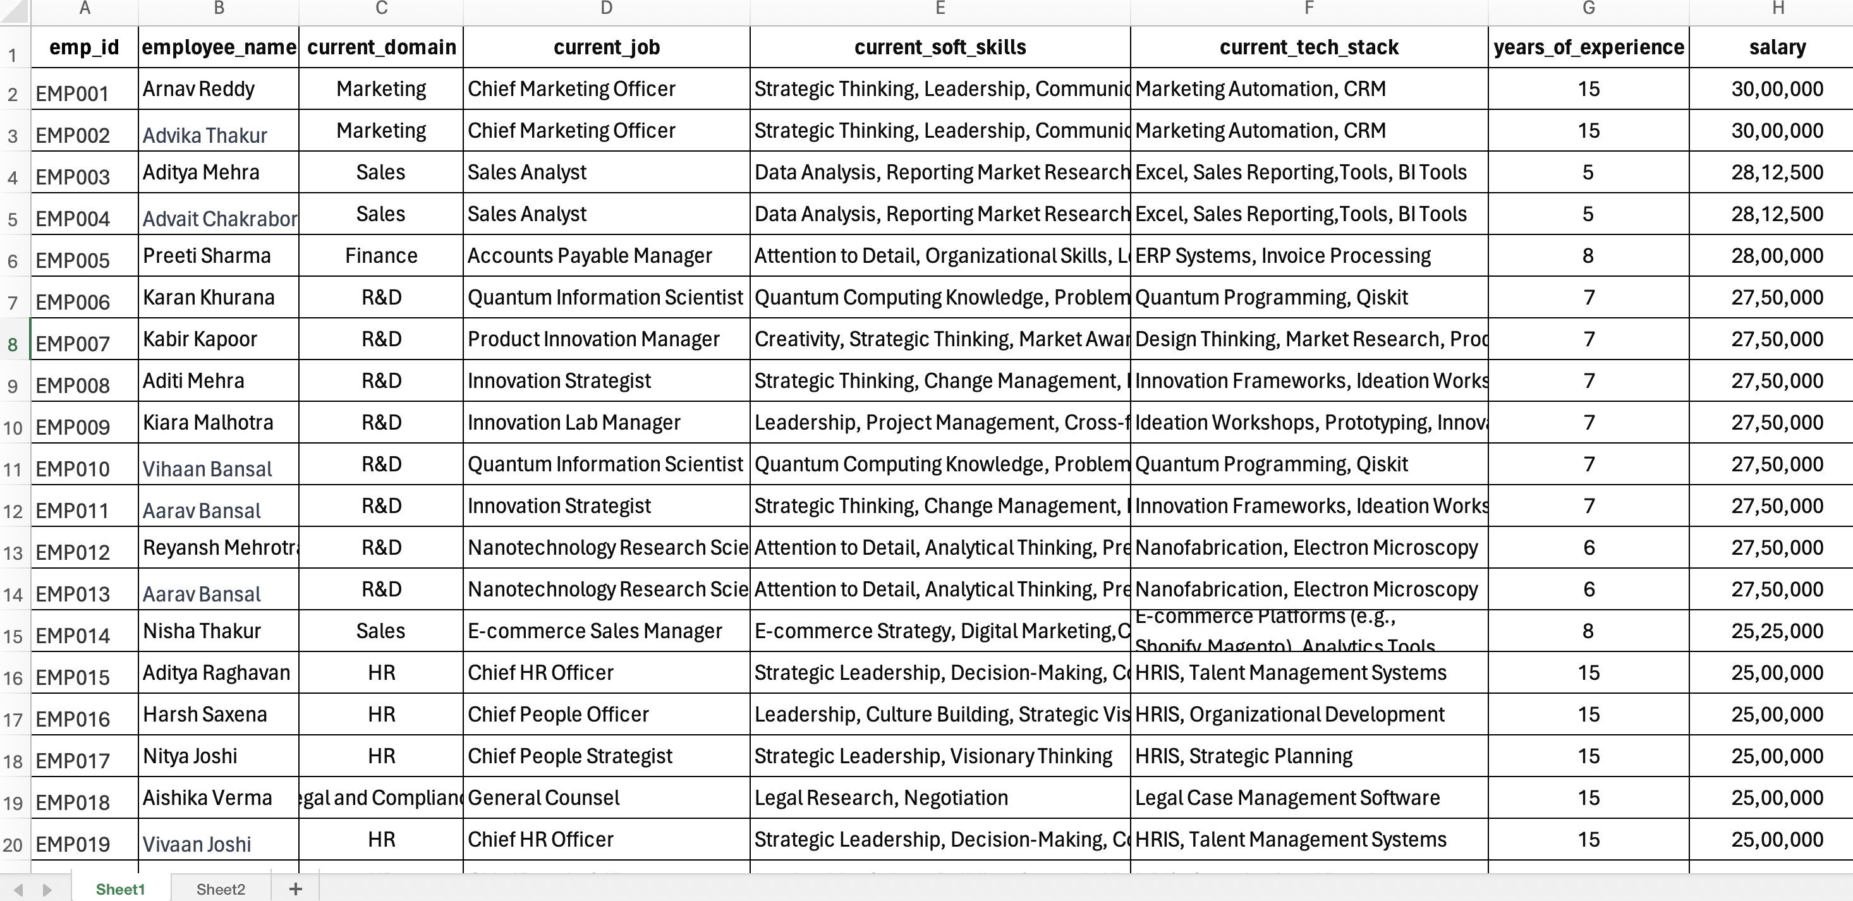
EMPLOYEE DATASET
887 X 8

Slide 6
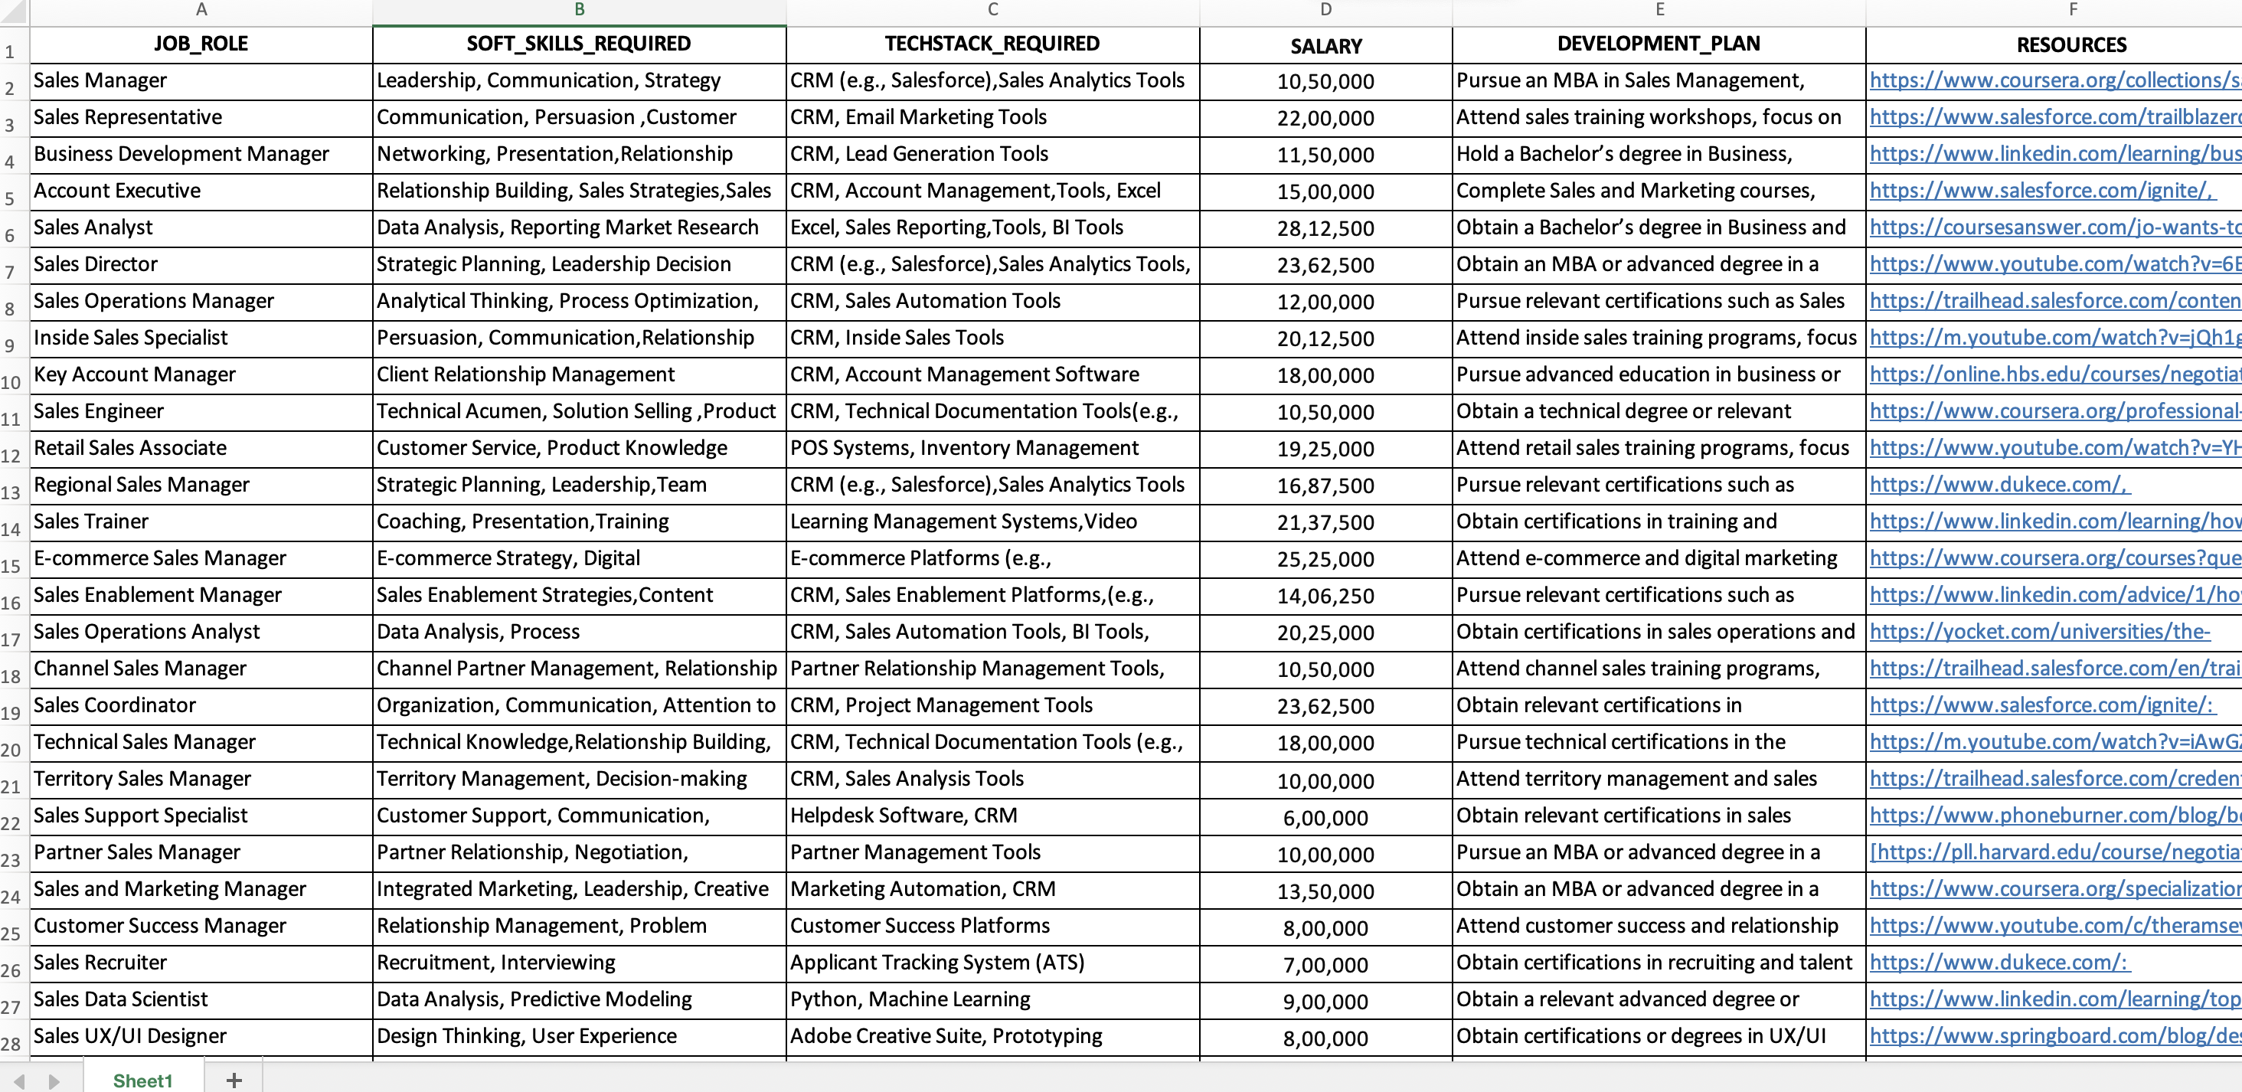
JOB DATASET
500 X 6

Slide 7
ABOUT OUR MODEL
Calculates cosine similarity between vectors representing employee skills and job requirements.
Uses percentile analysis to understand the range and variability of suggestions.
Uses Count Vectorizer to convert text data into numerical vectors.
Employs threshold-based evaluation to ensure reliability of recommendations, calculating the percentage of scores below or equal to this threshold to gauge the effectiveness of the system.

Slide 8
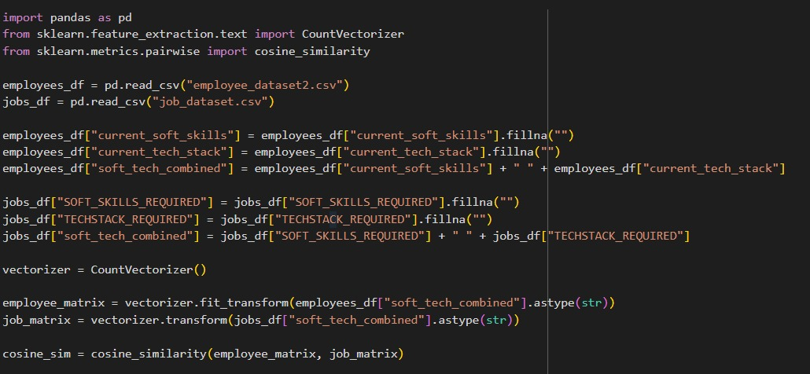

Slide 9
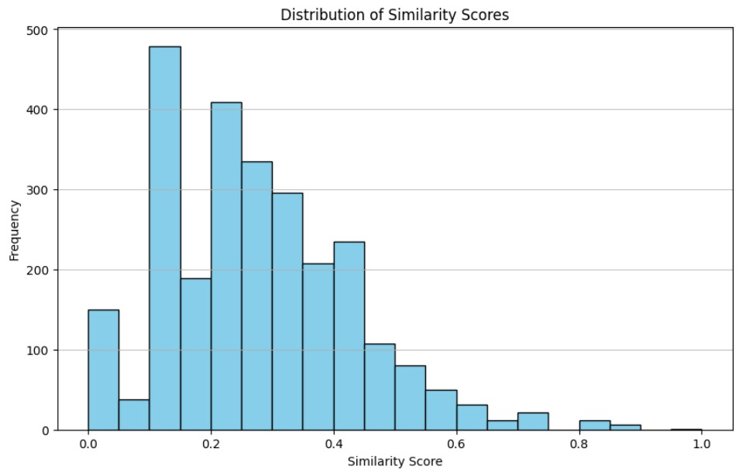

Slide 10
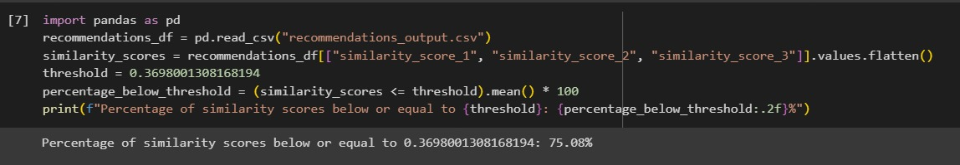

Slide 11
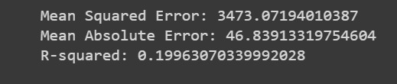
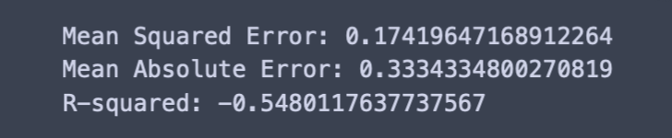
IMPLEMENTATION CHALLENGES
Multi-Output Regressor
Algorithm Used: Hist Gradient Boosting Regressor
Pre-processing Techniques:
Label Encoding
K-Nearest Neighbours
Algorithm Used: KNN
Pre-processing Techniques:
Label Encoding
TF-IDF

Slide 12
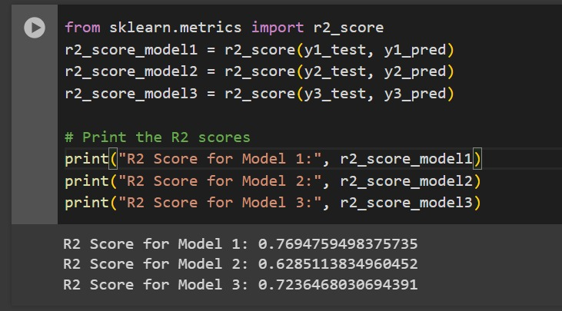
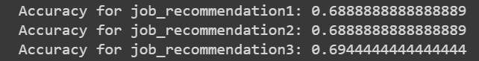
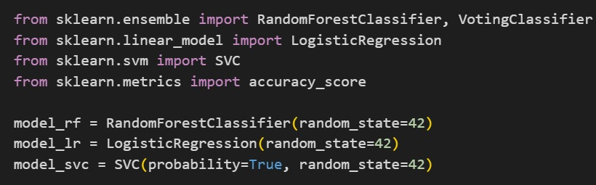
Natural Language Processing (NLP)
Algorithm Used: SVC
Pre-processing Techniques:
Label Encoding
One-Hot Encoding
Random Forest Classifier
Algorithm Used: Random Forest Classifier
Pre-processing Techniques:
TF-IDF Vectorization
One-Hot Encoding
Ensemble Method
Algorithms Used: Combination of multiple models
Pre-processing Techniques:
TF-IDF Vectorization
Label Encoder

Slide 13
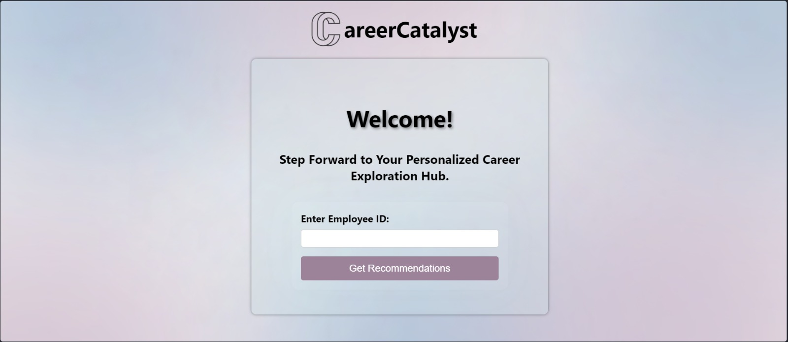
DEMO OF OUR MODEL

Slide 14
USP?
As a single corporate project, there is no risk of unauthorized access.
Respects user privacy.
The system protects data confidentiality.
Provides meaningful recommendations.

Slide 15


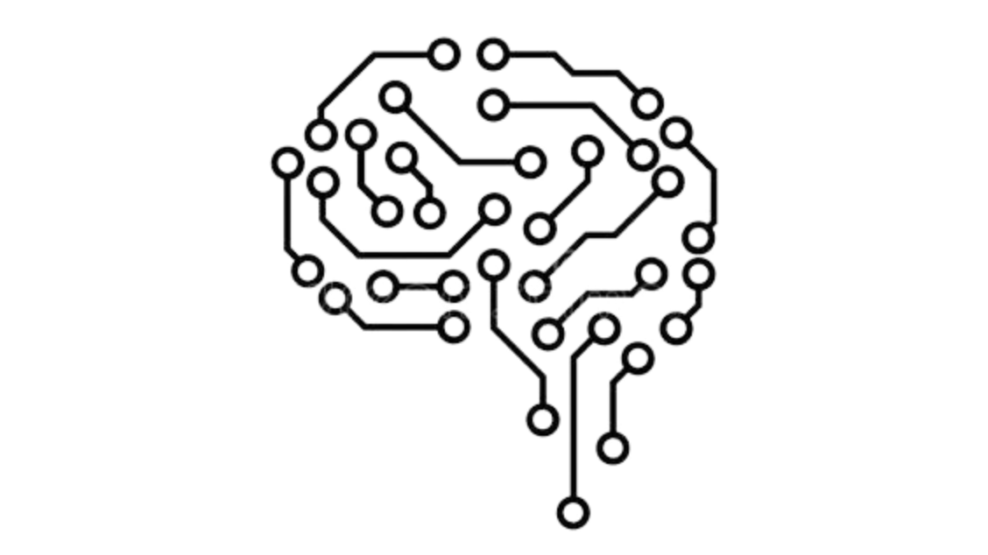



FUTURE WORK
Tracking progress of development plan
Updating Employee skills and profile
Introducing a comprehensive testing procedure to ensure the credibility of employee profiles
Improving UI for Dashboard Display
Increasing Security to maintain privacy of employee
Increasing accuracy by implementing scalable models

Slide 16
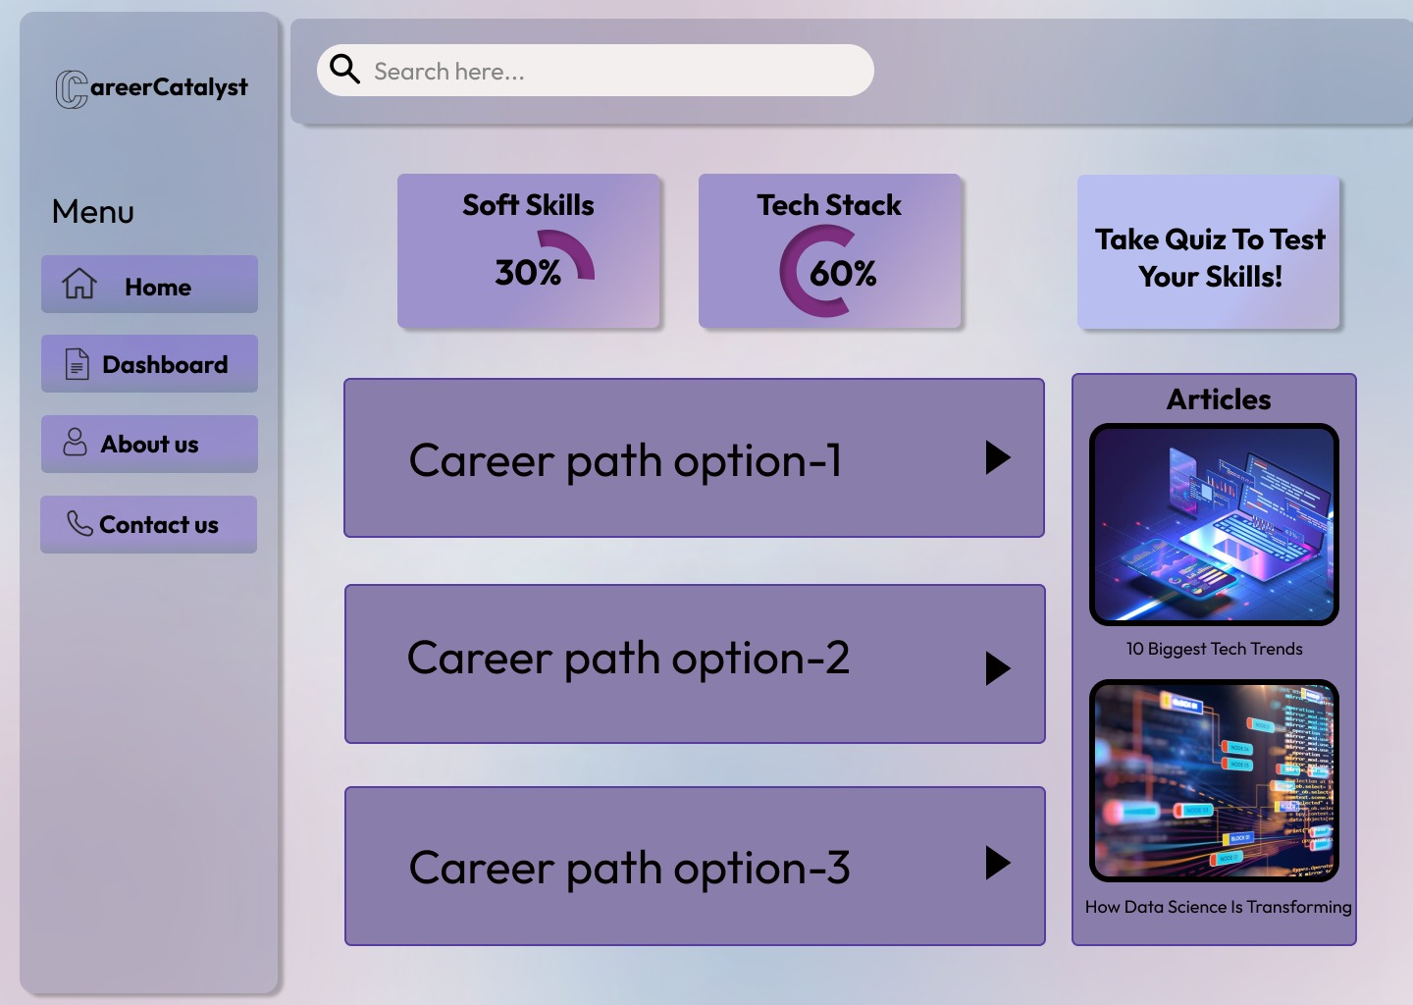

Slide 17
THANK YOU!
Any Questions?

